Slide 1
DATA ANALYTICS
MOVIE RECOMMENDATION SYSTEM
NAME | SRN
ROSHNI S | PES1UG20CS360
AKASH S | PES1UG20CS534
SAI MEGHANA | PES1UG20CS191

Slide 2
INTRODUCTION :
A recommendation system is a system that, depending on some data, makes suggestions to users for specific resources like books, movies, songs, etc.Recommendation engines have become more popular as e-commerce has expanded. A movie recommendation system is an approach to filter or predict the users’ film preferences based on their past choices and behavior or content. There are generally three ways of movie recommendation-content based, collaborative filtering and a hybrid of both.When creating a movie recommendation system, many variables can be taken into account, including the movie's genre, cast, and even director. The algorithms can suggest movies based on a single attribute or a combination of two or more.To improve the quality of a movie recommendation system, a Hybrid approach by combining content based filtering and collaborative filtering.Hybrid approach helps to get the advantages from both the approaches as well as tries to eliminate the drawbacks of both methods.

Slide 3
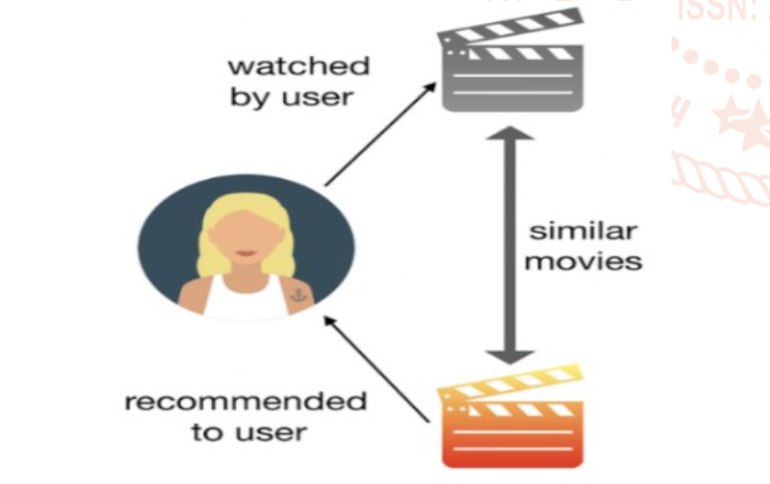
TYPES OF MOVIE RECOMMENDATION SYSTEMS :
1. SIMPLE RECOMMENDERS :
The simple recommendation system process provides generalized recommendations to each user, supporting movie popularity and / or genre. The basic approach behind this technique is that more popular and critically acclaimed movies will be likely to be liked by the general audience. For example, IMDB Top 250 is an example of this technique.
2. CONTENT BASED FILTERING :
Content-based filtering systems examine documents or user preferences to create a model based on this information. They employ the user's specific interests and make an effort to match the properties that the various content items to be recommended have to the user's profile. They additionally suffer from the drawback of needing a sufficient amount of data to create a solid classifier.-The point of content-based filtering system is to know the content of both user and item. Usually it constructs and then compare user-profile and item-profile using the content of shared attribute space.

Slide 4
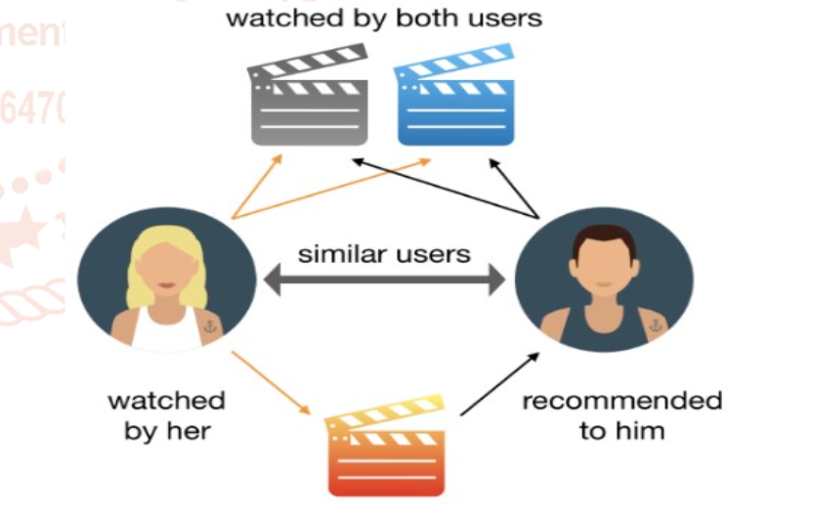
TYPES OF MOVIE RECOMMENDATION SYSTEMS :
3. COLLABORATIVE FILTERING :
Collaborative systems take inputs from many users and compare these inputs in various ways. They construct models based on users prior behavior. Systems for recommending movies, for instance, make use of user ratings for various films in an effort to connect with other users who share their opinions and suggest films they have enjoyed. Collaborative filtering systems have two approaches—memory-based approaches and model-based approaches . Both memory-based and model-based techniques are used in collaborative filtering. Memory-based methods continually examine user data before making recommendations. They gradually get more accurate as they use the user ratings. They don't need content analysis and are independent of domains. By creating a model of a user's past behavior, model-based techniques can then predict that user's future behavior using a set of parameters. Additionally, the employment of partitioning-based techniques improves accuracy and scalability.

Slide 5
TYPES OF MOVIE RECOMMENDATION SYSTEMS :
4. HYBRID SYSTEMS :
Hybrid systems combine collaborative and content- based filtering systems, in order to optimize the recommender systems, and reduce the drawbacks present in each of the two methods . Thus, it aims to maximize the advantages of one method while minimizing the drawbacks of the other. Weighted hybrid, mixed hybrid, and cross-source hybrid are the three different forms of hybrid systems. For each object in weighted hybrid systems, a score is kept, and the weighted aggregate is determined in relation to the numerous context sources. Depending on the user's settings, these are given varying weights. In mixed hybrid techniques, the top few items are chosen from each rank list after each source has been used to rank the various items. Hybrid cross-source approaches suggest things that show up in various context sources. These techniques operate under the premise that an item's importance increases with the number of sources it appears in.

Slide 6
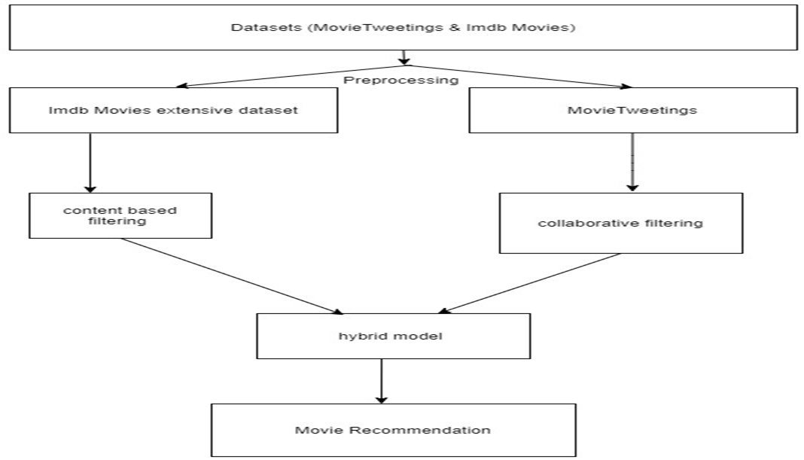

Slide 7
PROBLEM STATEMENT :
Recommendation systems are becoming increasingly important in today’s extremely busy world. People are always short on time with all the tasks they need to accomplish in the limited 24 hours. Therefore, the recommendation systems are important as they help them make the right choices, without having to expend their cognitive resources. We have decided to use hybrid approach as it gives better and accurate results than content based and collaborative filtering individually .It required less computational time and it meets all the advantages of content based and collaborative but the disadvantages are easily overcome.

Slide 8
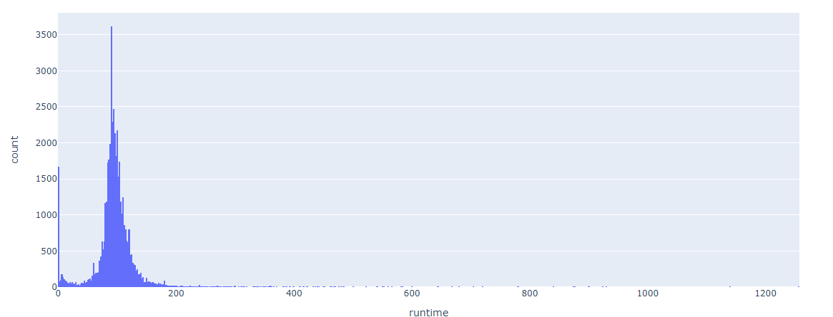
EXPLORATORY DATA ANALYSIS
First we read the dataset movies_metadata.csv from our drive and view all its columns.Then we view the shape of the data and its total size.We also plot a histogram of runtime to see various movies’ duration.
We perform certain data cleaning factors on revenue,vote_average and vote_count.

Slide 9
EXPLORATORY DATA ANALYSIS
Then we create a plotPerColumnDistribution function to plot the following histograms.
We plot a heatmap representing the correlation matrix which represents the relation between each columns with one another,i.e, interdependencies among each other.
Finally we plot a scatter plot which represents bi-variate or pairwise relationship between different combinations of variables while laying them in grid form.
Then we calculate c and m which represent the average of the votes by the people on those movies and their mean respectively. Then we extract the release year from release_date.
Then the qualifies movies are segregated by using 95% as cutoff.

Slide 10
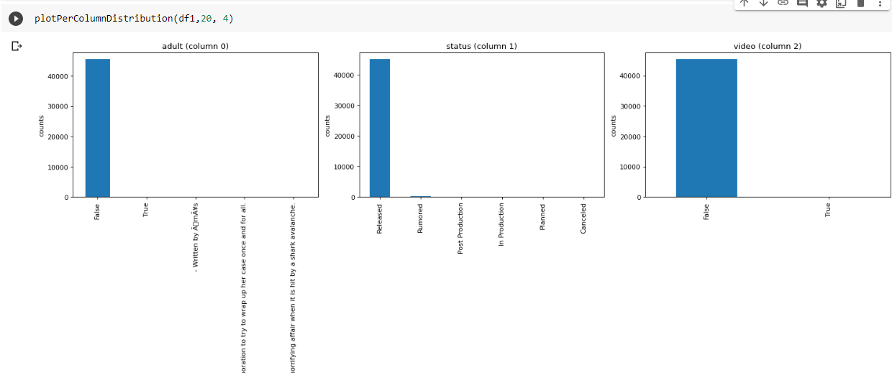
EXPLORATORY DATA ANALYSIS

Slide 11
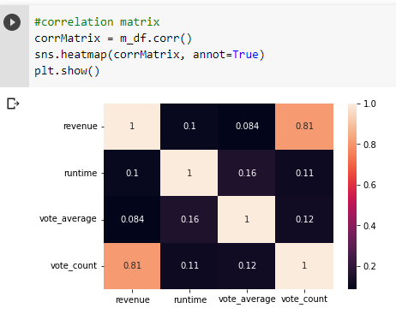
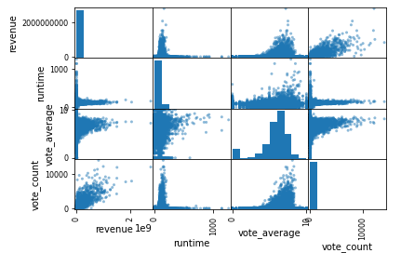
EXPLORATORY DATA ANALYSIS

Slide 12
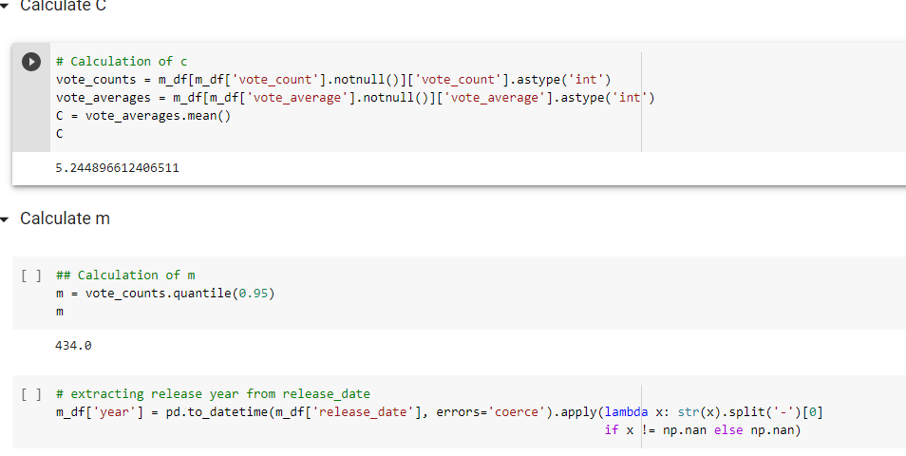
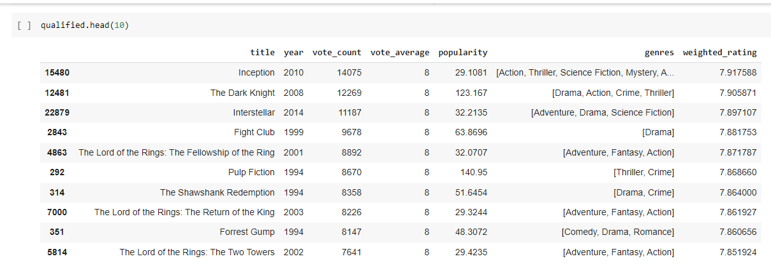
EXPLORATORY DATA ANALYSIS

Slide 13
LITERATURE SURVEY : (by Roshni S)
 | PAPER 1(CONTENT) | PAPER 2(COLLABORATIVE) | PAPER 3(HYBRID)
YEAR OF PUBLICATION | 2022 | 2020 | 2017
AUTHORS | Kiran Kumar,Gourab Pal Chowdhury, Sruti Bihani ,Rimpi Datta | Yogesh Kumar, Ms. Naveen Kumari | Shreya Agrawal,Pooja Jain
DATASETS | tmbd dataset | Movie Lens | Movie Lens (1M,Latest Small,10M dataset)
METHODOLOGY | Modelling-GridSearchCV and RandomisedCV,Cosinesimilarity,Python, Streamlit. | Improvised KNN classification and proposed classification. Combination of opinion mining and user similarity analysis. | Support Vector Machine as a classifier and genetic algorithm along with cosine similarity measure.
MERITS | Suffer far less from the cold start problem than collaborative approaches | The accuracy of classification is improved using NbSVM classifier and also meet the requirement of the users | It increases accuracy, scalability and quality of the movie recommendation system. Computing time of the proposed approach is lesser than the other two pure approaches.

Slide 14
LITERATURE SURVEY : (by Roshni S)
 | PAPER 1(CONTENT) | PAPER 2(COLLABORATIVE) | PAPER 3(HYBRID)
DEMERITS | New users or items with previously unseen features will logically suffer from cold start problem. | The prediction of the model for a given user, item pair is the dot product of the corresponding embeddings. | In the proposed method,memory consumed is high.
CONCLUSION | Five similar related movies will be displayed based on the choice of the movie you have given in the input. | Top-k movies are recommended for target user. The results suggested by this proposed system are leading and block buster movies and the system is helpful for millions and billions of users around the globe. | Hybrid approach helps to get the advantages from both the approaches as well as eliminates the drawbacks of both methods.
MOTIVATION | In the future it will continue to be researched and developed more to bring a good experience to the users. | In the future a more diverse dataset can be used to increase its accuracy. | In future we can also consider age of user as according to the age movie preferences also changes.And a way to reduce memory usage.

Slide 15
LITERATURE SURVEY : (by AKASH S)
 | PAPER 1(CONTENT) | PAPER 2 (collaborative) | PAPER 3(HYBRID)
YEAR OF PUBLICATION | 2018 | 2020 | 2020
AUTHORS | SRS Reddy, Sravani Nalluri, Subramanyam Kunisetti, S. Ashok and B. Venkatesh | Rakshitha. P,Varsha. R, Dr. Ashok Kumar | Rajeev Kumar1, Guru Basava2, Felicita Furtado
DATASETS | Movie Lens dataset | Movie Lens dataset | Movie Lens dataset
METHODOLOGY | User defined algorithm by calculating Euclidian distance. | Apache Spark | WCSS method , K-means clustering algorithm , RMSE (Roots stands for Mean Squared Error) is applied to calculate to rate the accuracy of the model.

Slide 16
LITERATURE SURVEY : (by AKASH S)
CONCLUSION | After computing the result matrix, the Euclidean distances with respect to the other users are obtained and the ones having the minimum value is recommended | RMSE value of the lowest will have an accurate RS from the movie lens dataset. | We have observed that the RMSE value of the proposed technique is healthier than the current technology after implementing the system with the help of python programming language.
MOTIVATION | All frameworks have their own benefits and issues but still not up to level to address all issues related to security, energy and user experience. Security issues are key problem in mcc, they need to be focused more compare to other issues. | ALS model, chosen with the following parameters of lambda and iteration of different values to check the performance of matrix factorization and the better performance of the RS. | In future, we can try and test the system using more data and improve the accuracy of the system. In addition, we can try users better to increase the accuracy of the recommendation system.

Slide 17
LITERATURE SURVEY : (by SAI MEGHANA)
 | PAPER 1(CONTENT) | PAPER 2 (collaborative) | PAPER 3(HYBRID)
YEAR OF PUBLICATION | 2008 | 2020 | 2021
AUTHORS | Charilaos Zisopoulos, SAvvas Karagiannidis, Stefanos Antaris | Meenu Gupta, Aditya THakkar, Aashish,Vishal Gupta, Dhruv Pratap Singh Rathore | Rajeev Kumar, Guru Basava, Felicita Furtado
DATASETS | Movie lens | Movie Lens | Movie Lens
METHODOLOGY | Cosine similarity and tfid vectorisation | Item based collaborative filtering using KNN and cosine similarity | Its a survey

Slide 18
LITERATURE SURVEY : (by SAI MEGHANA)
MERITS | Due to usage of cosine similarity results are better. | The MAE value of our proposed system is 0.248 which is lesser than other recommendation system | We get to know that using hybrid method gives better results.
DEMERITS | Scalability,Data sparity,cold start problem | Cold start problem | Each method has its own demerits.
CONCLUSION | Proposal frameworks uses continuous data from wearable devices and snap stream to generate more advanced results are more successful. | to avoid the use of content-based filtering, the Item-based CF filtering approach is used for obtaining better results. KNN collaborative recommendation system is proposed using cosine similarity | A survey on all methods gives us knowledge of all varieties and tells us what method to use for what purpose.
MOTIVATION | the suggested results from a health care field suggestion framework | The contentbased filtering and collaborative filtering can be combined to minimize the errors and improve the performance as a hybrid approach. | By combining methods the problems related to the two methods are tried to resolve.

Slide 19
TECHNIQUES USED IN PROPOSED METHODOLOGY :
1. Cosine Similarity matrix :
Cosine similarity is the cosine of the angle between two vectors and it is used as a distance evaluation metric between two points in the plane. The cosine similarity measure operates entirely on the cosine principles where with the increase in distance the similarity of data points reduces. Cosine similarity in the recommendation system is used with the same principle of cosine angles, where even if the similarity of the content is less similar it would be considered as the least recommended content, and for higher similarity of contents, the recommendations generated would be at the top.

Slide 20
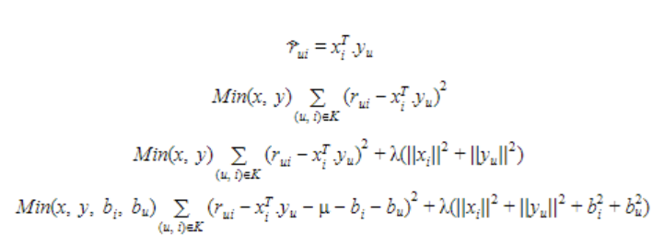
2. SVD (Singular Value Decomposition) :
SVD is used as a collaborative filtering technique. It uses a matrix structure where each row represents a user, and each column represents an item. The elements of this matrix are the ratings that are given to items by users.
Where A is a m x n utility matrix, U is a m x r orthogonal left singular matrix, which represents the relationship between users and latent factors, S is a “r x r” diagonal matrix, which describes the strength of each latent factor and V is a “r x n” diagonal right singular matrix, which indicates the similarity between items and latent factors. The SVD decreases the dimension of the utility matrix A by extracting its latent factors. It maps each user and each item into a r-dimensional latent space. This mapping facilitates a clear representation of relationships between users and items.

Slide 21
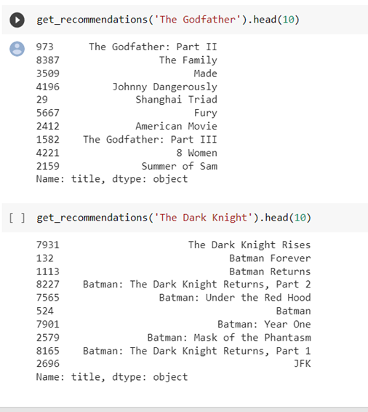
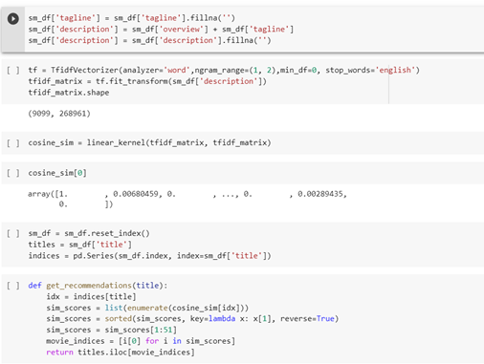
METHODOLOGY :
CONTENT BASED RECOMMENDATION MODEL :
We have used text vectorization and then implemented cosine similarity to perform content based recommendation. We have used overview and tagline of the movies for getter better recommendation results. We have used details of the movie from links-small.csv file. So the movies are suggested based on the content and description of movies.

Slide 22
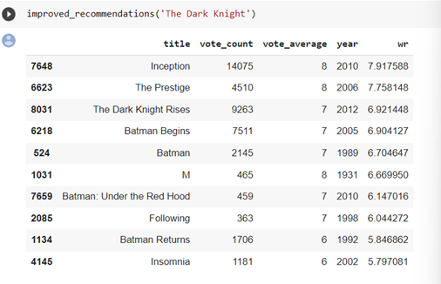
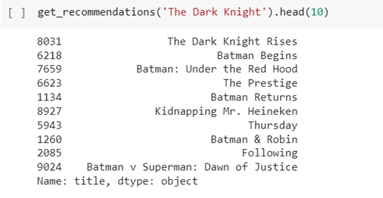
2. METADATA BASED RECOMMENDATION MODEL
First we create a dataframe with required information to the movie dataframe from credits.csv and keywords.csv and then we create a improved recommendation model using details such as vote_count and vote_average to get better results.

Slide 23
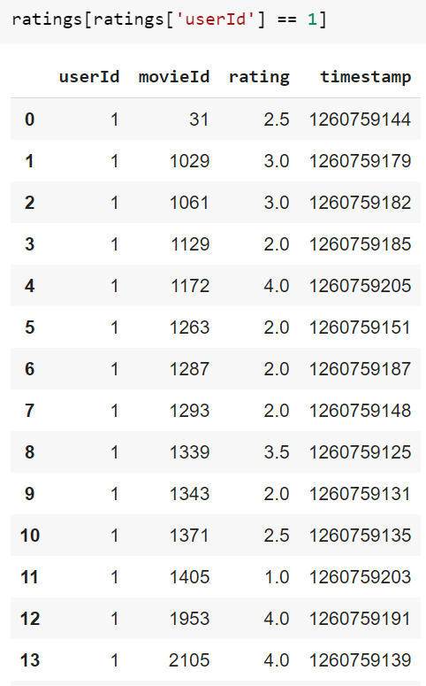
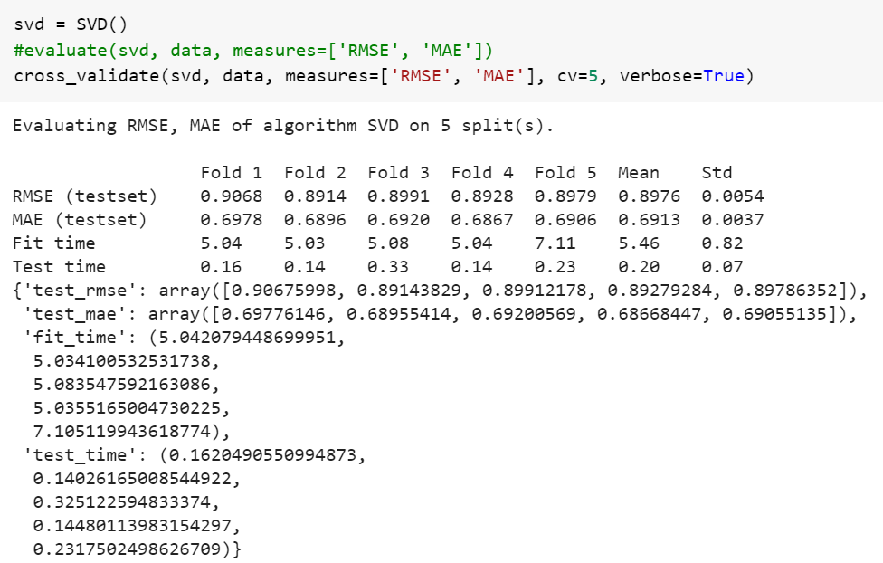
3. COLLABORATIVE FILTERING MODEL :
In this we consider that the user rates movies according to his liking and when another user watches the movie watched by the previous user then the movies are suggested to this user according to the prior user’s liking represented as rating. We have used SVD technique to implement this. We have used data from raitings_small.csv and links_small.csv.

Slide 24
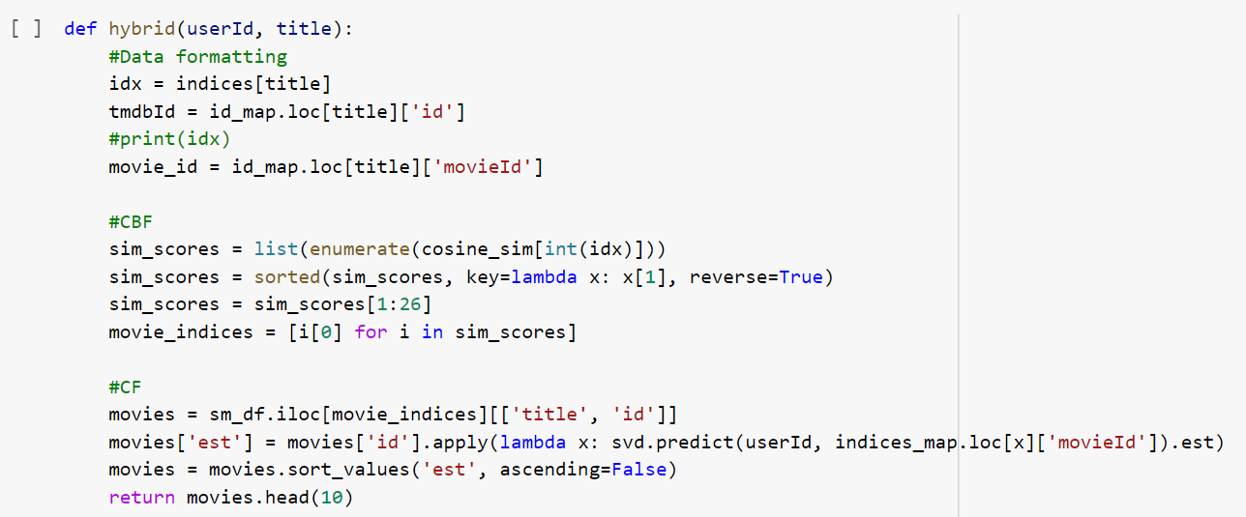
4. HYBRID RECOMMENDATION SYSTEM
In this we combined both content and collaborative techniques which results in an effective model which has advantages of both content based and collaborative filtering but cancels out the drawbacks of the respective methods. Therefore this method can be considered one of the effective method for recommendation systems. We consider userid and movie name for further recommendations.

Slide 25
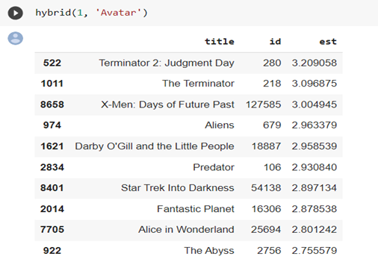
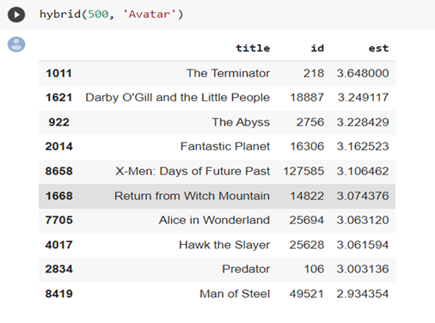

Slide 26
CONCLUSION :
The Hybrid”s Model is a combination of both content and collaborative techniques which results in an effective model which has advantages of both content based and collaborative filtering but cancels out the drawbacks of the respective methods. Therefore this method can be considered one of the effective method for recommendation systems.
FUTURE WORK :
We can expand the recommendation system by using a larger dataset and see how it works . By a larger dataset we mean to use a larger user ratings and opinions for a better recommendation system. We can further improve by creating a GUI or an app or even a website which can be user friendly. In future, we plan to make this system more accurate and platform for listing out movies with their metadata, where users can rate movie and get more accurate recommendation. This will help us to maintain user profiles more precisely. Currently our models support only English movies, in future we will add dataset of regional movies.

Slide 27
REFERENCES :
sowmyashreem/Hybrid-Movies-Recommendation-System: Hybrid Movie Recommender system that uses concepts of 2 of the most popular recommender techniques: Collaborative and Content-based Filtering. (github.com)
MovieTweetings EDA for DA | Kaggle
(PDF) Movie Recommendation System (researchgate.net)
Movie Recommendation System using content based filtering (jetir.org)
An improved approach for movie recommendation system (researchgate.net)
DA.ipynb - Colaboratory (google.com)
https://www.researchgate.net/publication/331966843_Content-Based_Movie_Recommendation_System_Using_Genre_Correlation
https://www.ijtsrd.com/engineering/information-technology/30737/an-efficient-content-collaborative-%E2%80%93-based-and-hybrid-approach-for-movie-recommendation-engine/rajeev-kumar
https://www.ijert.org/recommendation-of-movies-based-on-collaborative-filtering-using-apache-spark
2017, IEEE. 4. P. Phorasim and L. Yu, “Movies recommendation system using collaborative filtering and k-means,” International Journal of Advanced Computer Research, vol. 7, no. 29, p.52, 2017
C. S. M. Wu, D. Garg, and U. Bhandary, “Movie Recommendation System Using Collaborative Filtering,” In 2018 IEEE 9th International Conference on Software Engineering and Service Science (ICSESS), pp. 11-15, IEEE, 2018 Nov.
https://www.iteratorshq.com/blog/an-introduction-recommender-systems

Slide 28
THANK YOU

